Slide 1
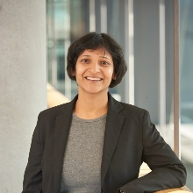
Seminar on - 'Driving Markets through Innovation and Entrepreneurship'. September 2nd , 2022 between 2.30 – 3.30 PM at G1 - FMC Distinguished Speaker: Dr. Nivedita Agarwal Research Fellow Institute of Entrepreneurship and Innovation Science, University of Stuttgart, Germany and Program manager for Technology and Innovation Management at Siemens Healthineers AG, Germany

